Slide 1
Introduction to UI/UX Design
World of User Interface and User Experience

Slide 2
Agenda
Definition of UI/UX
Importance of UI/UX in Digital Products
Overview of the Design Process
Key Differences between UI and UX

Slide 3





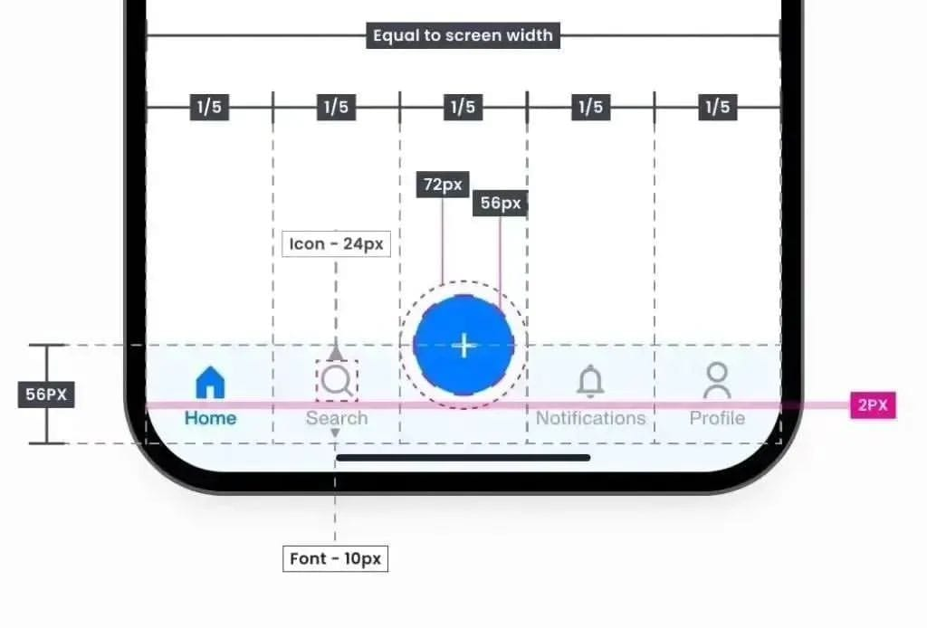
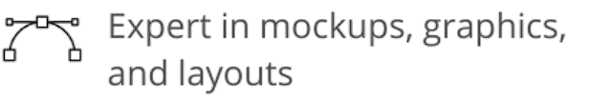
UI/UX
UI /User Interface
The visual elements and design of a product that users interact with.

Slide 4


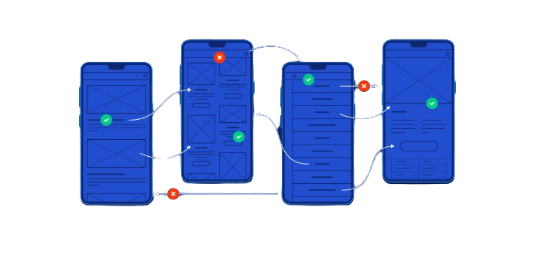


UI/UX
UX /User Experience
The overall experience a user has with a product, encompassing usability, accessibility, and satisfaction.

Slide 5

Importance of UI/UX in Digital Products
Captures User Attention
Enhances User Satisfaction
Builds Brand Credibility
Increases User Engagement
Boosts Conversion Rates

Slide 6

Design Process
Understand the Problem
Research and Discovery
Ideation and Sketching
Wireframing
Prototyping
User Testing
Refinement and Iteration
Final Design

Slide 7
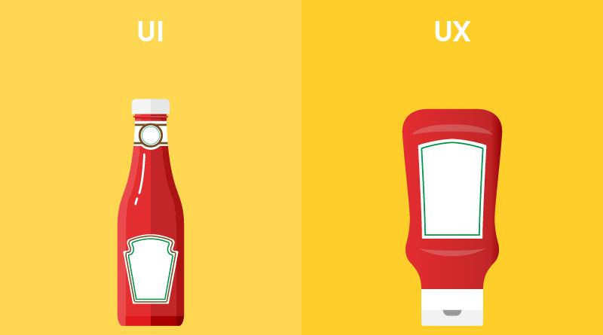
Key Differences between UI and UX
UI focuses on the look and feel of the product.
UX is concerned with the overall user experience, including usability and functionality.
UI involves visual design, while UX encompasses the entire user journey.

Slide 8
Questions and Discussion
Let’s Learn in Deep

